Slide 1
Basic I/O Interfacing

Slide 2
Overview
A Microprocessor is a great tool for solving problem but is of little or no use if it can’t communicate with other devices.
Today we are going to learn some basic concepts about I/O Interfacing of the microprocessor.
We will learn about a device 82C55 which is very widely used in microprocessor interfacing.

Slide 3
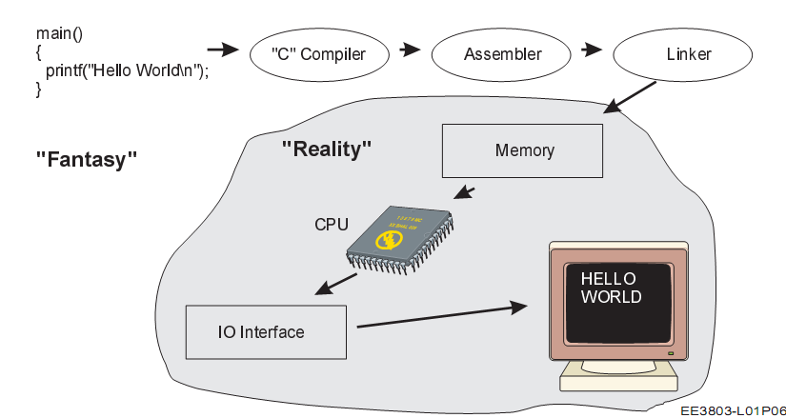

Slide 4
I/O Instructions
IN is the instruction that reads information from an I/O device.
Read data from a port/device we used the IN instruction.
OUT is the instruction that writes/sends data to an I/O device.
We also used this instruction to send data to various devices that were interface with the microprocessor.
What is the instruction to read/write data from memory?
Further instructions such as INS and OUTS is also available on modern microprocessor to send strings of data.

Slide 5
I/O Instructions
Remember we used a simulator in the labs which only simulated a subset of functions, registers and instructions of the microprocessor.
OUT 01 - To send the contents of AL to device connected to Port 1
IN 01 – To read data from device connected to Port 1 and store in AL.
In the real microprocessor this structure is slightly different.

Slide 6
I/O Instructions
Whenever we used IN and OUT instructions, the I/O address is often called a port number.
The port numbers appear on the address lines just as addresses of memory would when we access memory.
Remember memory decoding ? Port numbers are also decoded to enable I/O devices the same way.
If we use p8 only 8 bits are used thus the address or port number appears on lines A0-A7
If we use DX we used16 bits thus the address or port number appears on lines A0-A15

Slide 7
I/O Instructions
This also means that the first 256 I/O port addresses (00H – FFH) are accessed by both fixed and variable I/O instructions.
But addresses 0000H-FFFFH are only accessed by variable I/O Address instructions.
The other thing that you need to note is INS and OUTS transfers data between memory and the I/O device.
The memory location for INS instruction is obtained by ES:DI
The memory location for OUTS instruction is obtained by DS:SI

Slide 8
Example
Data are to be read in from two byte-wide input ports at address
AA and A9, respectively, and then output as a word to a word-wide
Output port at address B000. Write a sequence of instructions to
Perform this I/O operation
IN AL, AA ; move data in from port address AA
MOV AH,AL ; move data from AL to AH
IN AL,A9 ; move data from port address A9
MOV DX, B000 ; move port address B000 to DX
OUT DX, AX ; can I do OUT B000, AX instead ??????
AH
AL
Data from AA
Data from A9

Slide 9
Isolated and Memory Mapped I/O
There are two types of I/O interfacing
Isolated I/O
Memory Mapped I/O
Memory Mapped I/O
This where a device is mapped to a memory location. Sending data to the particular location causes interaction with the device.
IN, OUT, INS and OUTS do not need to be used. Simple MOV instructions does the trick.
Advantages: Less complication, less circuitry, less decoding and no need to use special signal.

Slide 10
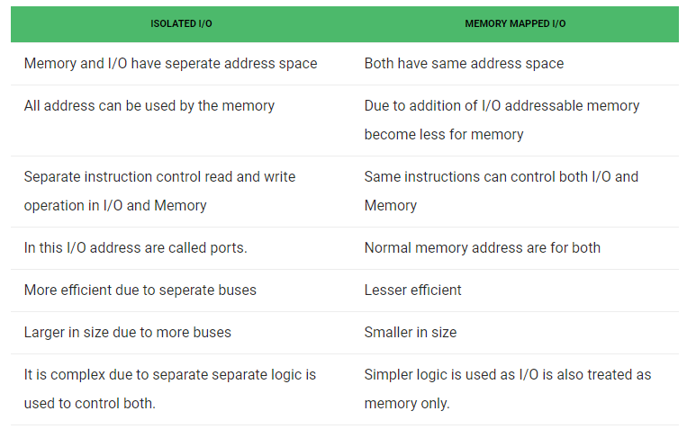
Differences between Isolated I/O and Memory Mapped I/O

Slide 11
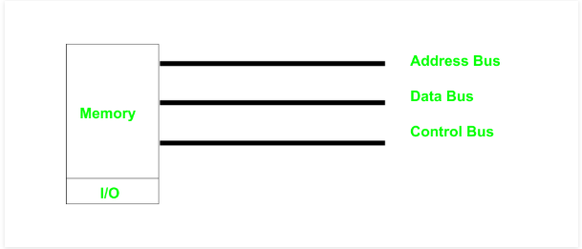
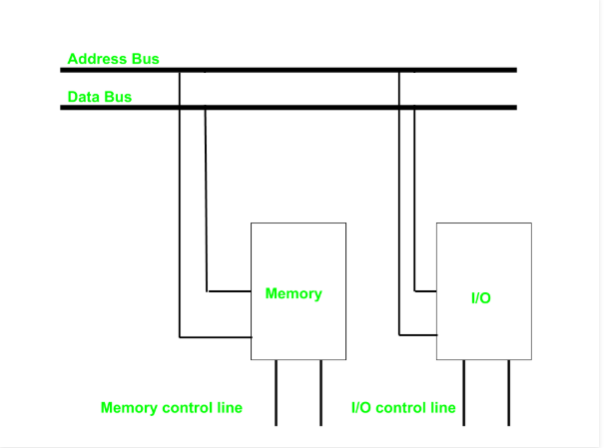
Memory Mapped I/O
Memory + I/O
FFFFF
I/O
00000

Slide 12
Isolated I/O
This is the most common form of I/O transfer technique used with Intel processors.
The term isolated means that the memory is separate from the I/O addresses.
The isolated I/O addresses are thus referred to as Ports
So in this system no memory is wasted for I/O mapping.

Slide 13
Isolated I/O
A disadvantage is special instructions such as IN, OUT, INS and OUTS need to be used to perform data transfer.
Separate signals are also needed to interact with the I/O devices which separate it from normal memory access instructions.
M/IO – Used to select Memory or I/O
I/O read – IORC
I/O write - IOWC
On Personal computers Isolated I/O is used.
8 bit port addresses are used to access devices located on system board.
16 bit port address are used to access serial and parallel ports as well as video and disk drive systems.

Slide 14
Isolated I/O
Memory
FFFFF
1M X 8
I/O
FFFF
64K X 8
0000
Page 364 of the book shows the I/O for an PC. Ref: the Intel Microprocessors: 8086…..
00000

Slide 15
I/O Port Address Decoding
This uses the same concept as memory decoding.
Memory mapped I/O is the same as memory decoding.
Hence, we only discuss isolated I/O decoding.
In Memory decoding we decoded the entire set of pins.
A0 – A19/A23/A31
In Isolated I/O Addressing we only need to decode A0-A15. (Remember they are either 8 bit or 16 bit)
If the system only employs Fixed I/O Addressing we only need to decode A0-A7.
For personal computers we always decode all 16 bits.

Slide 16
8 bit I/O Addresses
Fixed I/O uses 8 bit I/O port addresses that appears on A0-A15 as 0000H – 00FFH.
If a system will never have more than 256 I/O Devices we can get away with decoding only A0-A7. The rest can be ignored.
Ignored pins that don’t matter or are not used are said to be in “Don’t Care” state in microprocessor terms.
The variable system can also employ 8 bits if necessary and can address 00H – FFH. If address is decoded as a 8 bit address we can never include I/O Devices that use 16 bit I/O Addresses.

Slide 17
The programmable peripheral Interface
The 82C55 programmable peripheral interface (PPI) is a very popular low-cost interfacing component that is used found in many applications.
Applications range from 7-segment display, stepper motor connection, counters to key pad management.
This device is still in use today in P4 Computers and is used to interface and detect key presses on modern keyboards, parallel printers and other interfacing chipsets.
For those of you who are doing computer interfacing course you will be extensively using this device to interface various devices with the PC.

Slide 18
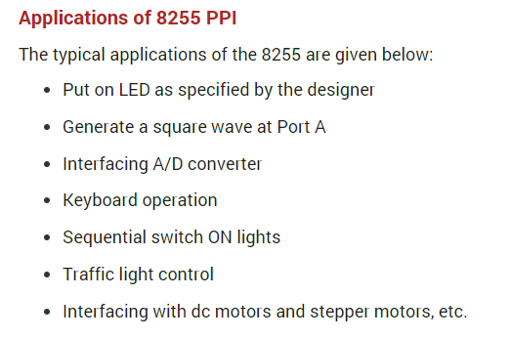


Slide 19
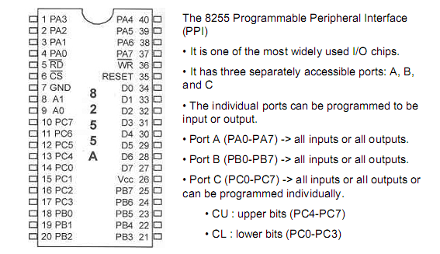
8255 Programmable Peripheral Interface

Slide 20
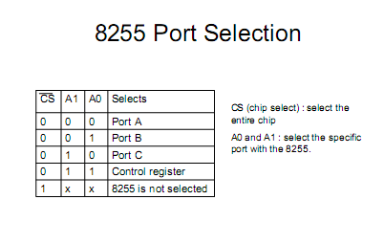
CS pin is used to select the device for reading or writing.

Slide 21
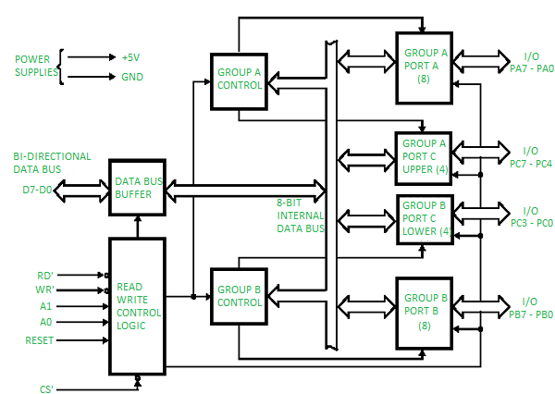
82C55 Block Diagram / Architecture

Slide 22
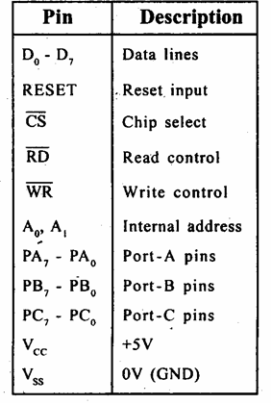
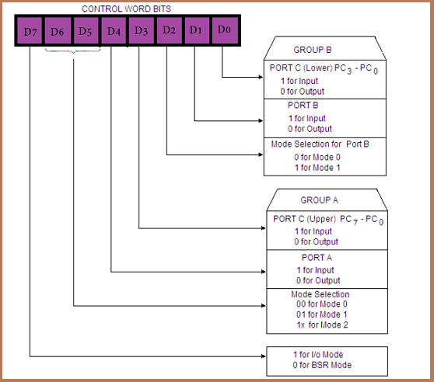
(a)
(b)
a) Pin description
b) Control Word Format

Slide 23
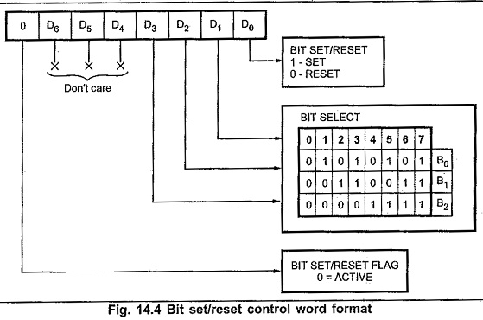

Slide 24
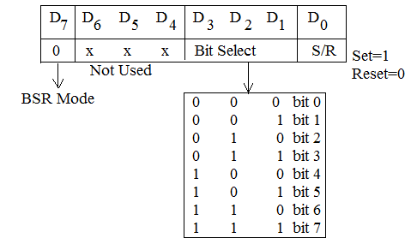
Control Word Format in BSR mode

Slide 25
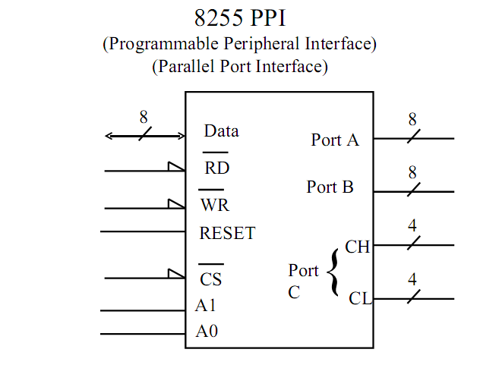

Slide 26
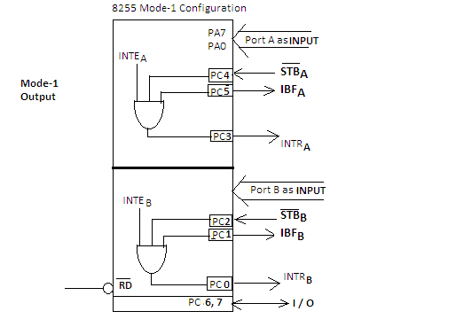
Input Handshaking (mode 1)

Slide 27
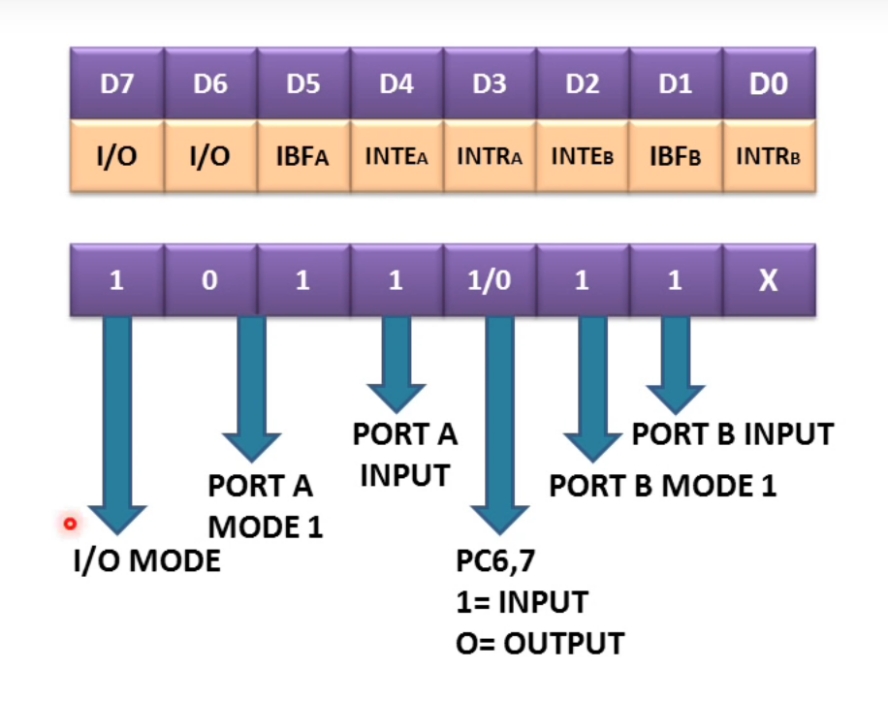

Slide 28
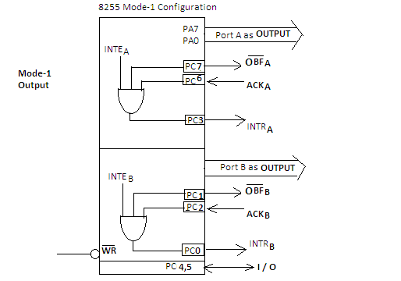
Output Handshaking (mode 1)

Slide 29
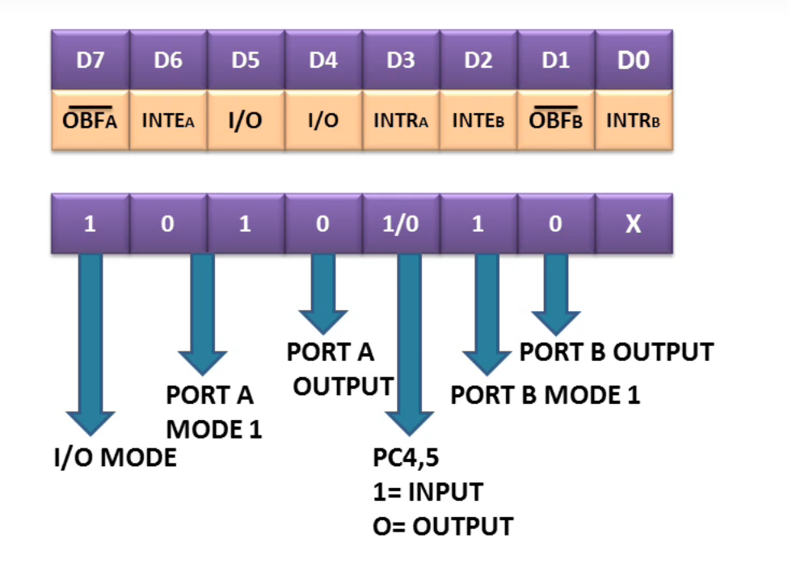

Slide 30
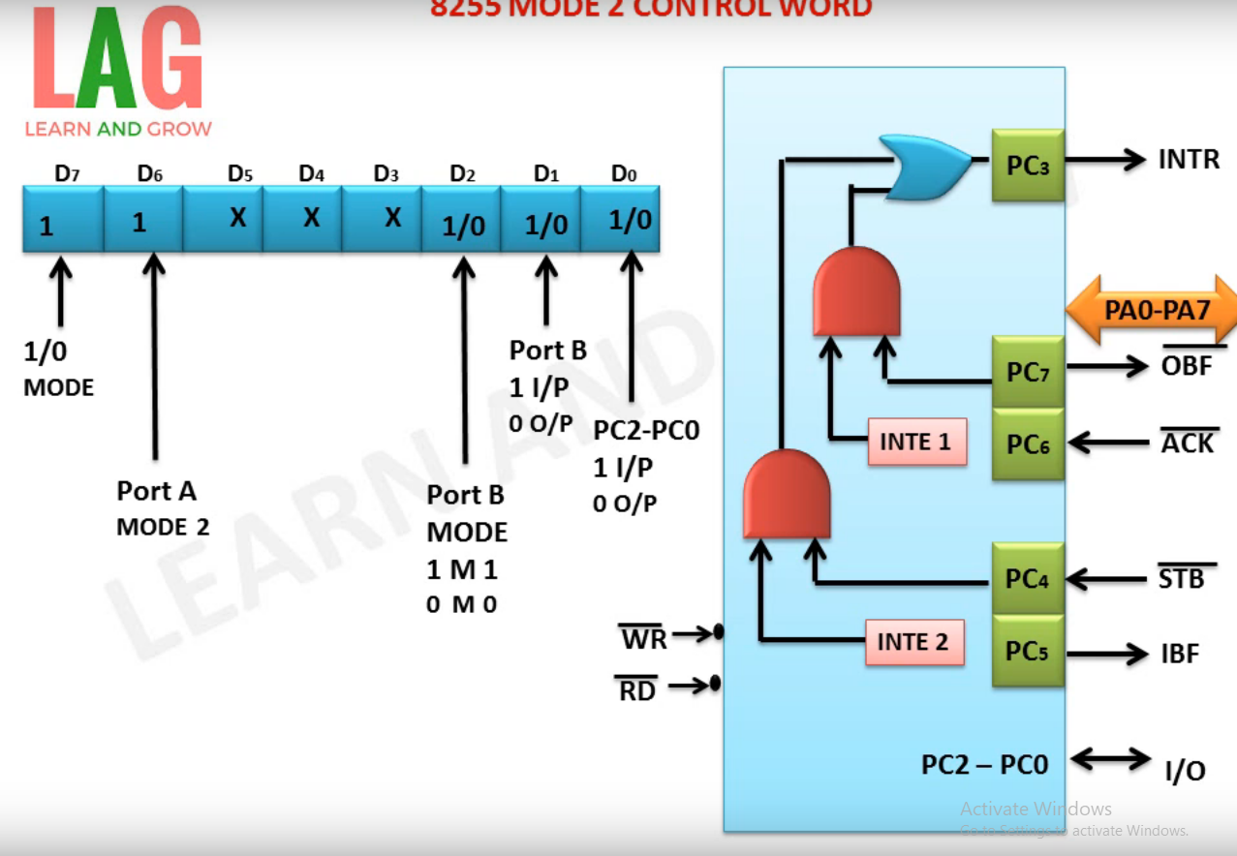

Slide 31
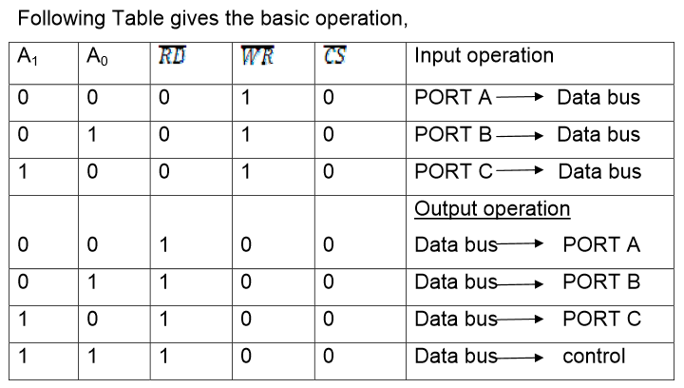

Slide 32
82C55
This devices has 24 pins for I/O.
The I/O pins can be programmed in groups of 12 pins.
There are three distinct modes of operation Mode 0, Mode 1 and Mode 2.
Group A connections consists of Port A(PA0-PA7) and the upper half of port C (PC4-PC7)
Group B connections consists of Port B (PB0-PB7) and the lower half of port C (PC0-PC3)

Slide 33
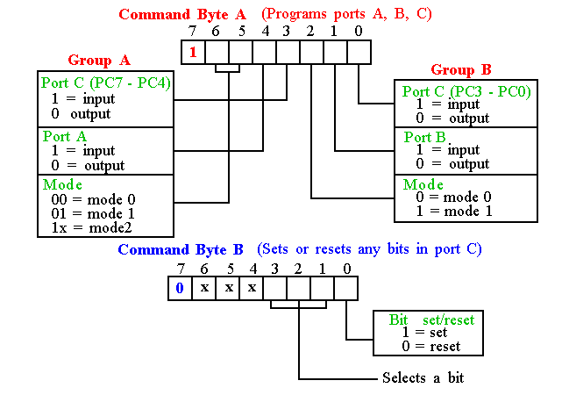
Programming 8255
8255 has three operation modes: mode 0, mode 1, and mode 2

